Slide 1
Faster Cash,
Far Less Effort
Bulk Supply Chain Automation
Natively Inside SAP S/4HANA
Notes:
Title: Blunt and to the point, it’s Vegas!
Alternatives:
Where Bulk Product Meets the Books
Get Paid Faster on Every Bulk Delivery
Less Reconciling, More Deciding
Your Supply Chain, Settled Faster

Slide 2
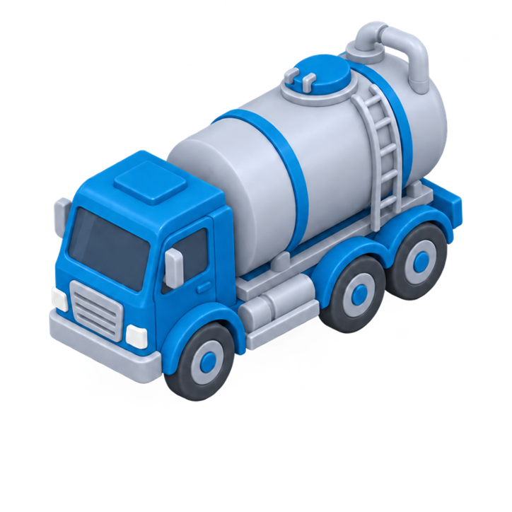
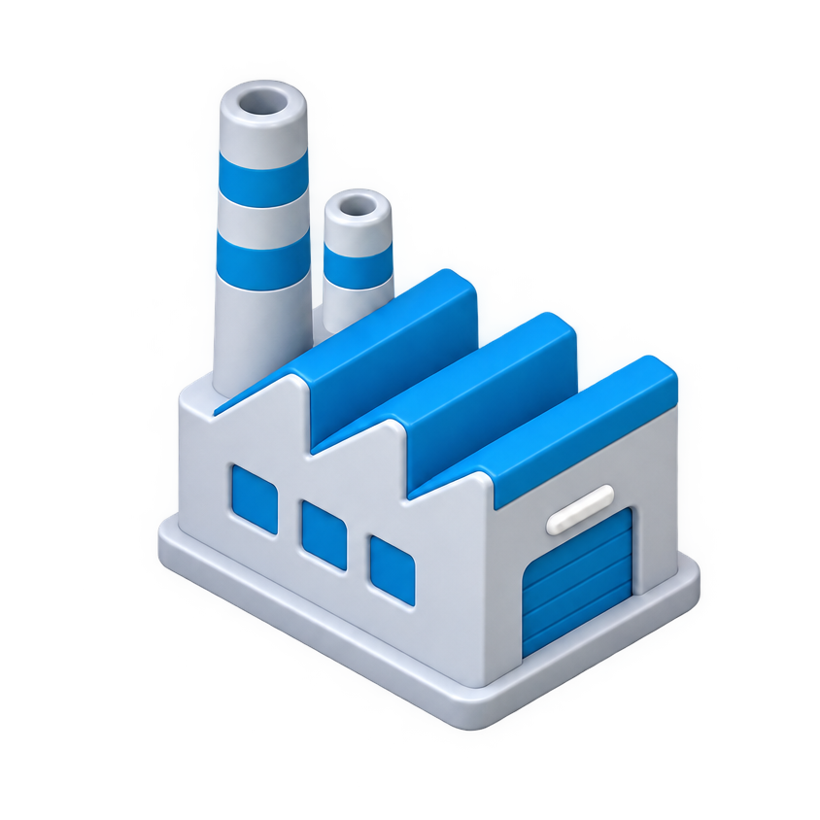
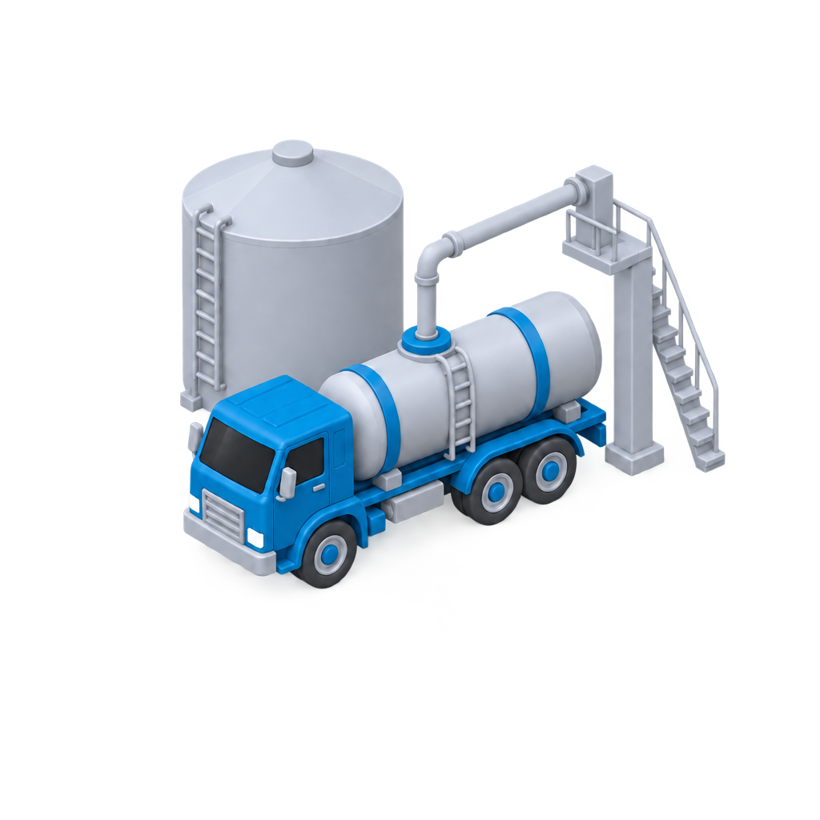
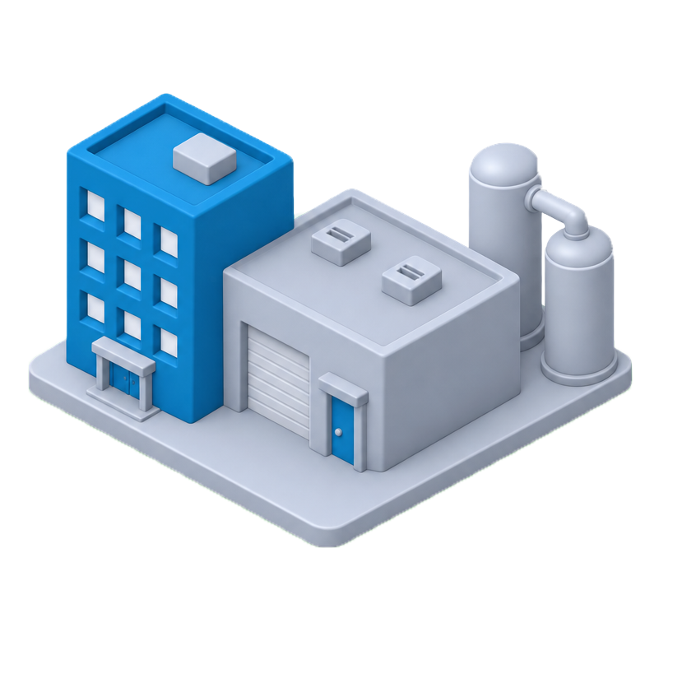
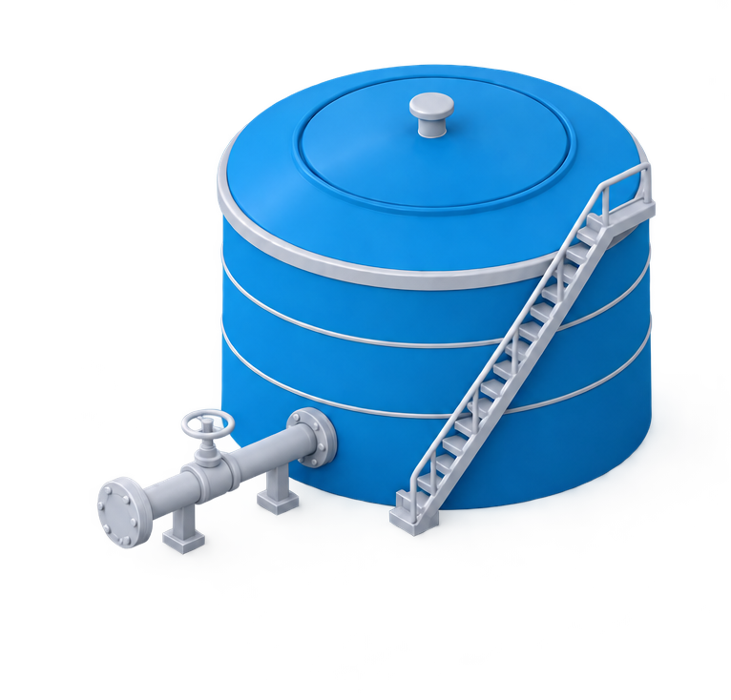
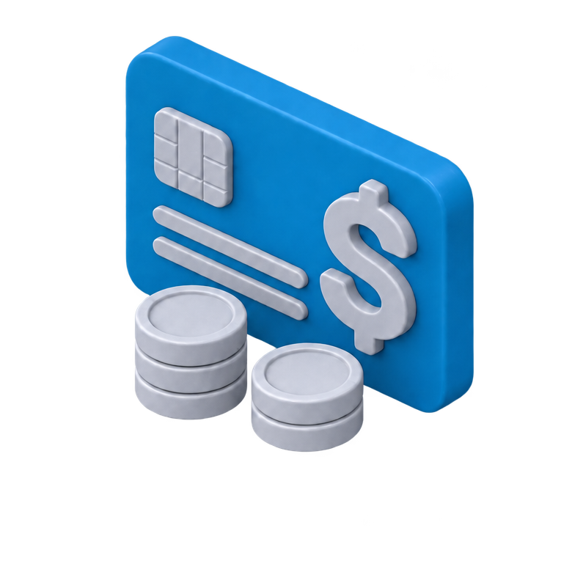
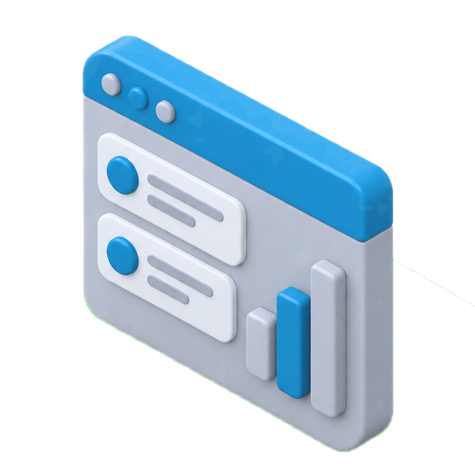
Connecting Finance and Logistics, Autonomously
Supplier
Delivery from
Supplier
Production &
Movement
Storage
Loading
Delivery to
Customer
Payment
Physical Bulk
Supply Chain
Inbound
Production
Outbound
SAP S/4HANA
Secondary Distribution & Automation Management
Monitor
Reconcile
Post
with Agentic AI & Autonomous SCM*
Exceptions
Orchestrate
Order
Forecast
Configure
*Labs Preview + Roadmap
SAP Business
Process
Purchase
Order
Goods Receipt
Manufacturing,
Stock Transfer
Sales Order
Planning, Dispatch, Loading
Delivery,
Unloading
Billing, Payment,
Financial Close
Clear Benefit
Get paid faster,
with far less effort
Margin transparency, clean data for AI and planning
Close books easily,
stay audit-ready
Future proof part of Autonomous SCM,
natively in SAP S/4HANA
Seamlessly integrated into the SAP landscape — enabling end-to-end processes and maximum value.
Notes:
Elevator Pitch Overview:
Option A:
Your finance system shouldn’t have to play catch-up while your trucks keep product moving.
SAP SDM closes the gap automatically and intelligently, turning every delivery into an accurate, audit-ready SAP transaction.
Get paid faster, reduce manual effort, and run on data you can trust.
Already part of SAP S/4HANA, and the Autonomous Supply Chain
Option B:
SAP S/4HANA SDM protects the quality of financial and inventory data by continuously reconciling what physically happens in the bulk supply chain with the SAP business process — and automatically making the required adjustments across the document chain.
Other options/suggestions, what works best for you?

Slide 3
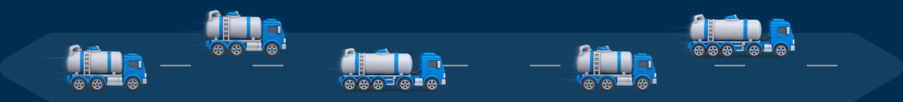
Bulk Supply Chain Challenges
Inbound
Production
Outbound
Supplier
Delivery from
Supplier
Production &
Movement
Storage
Loading
Delivery to
Customer
Payment
Physical Bulk
Supply Chain
SAP Business
Process
Purchase
Order
Goods Receipt
Manufacturing,
Stock Transfer
Sales Order
Planning, Dispatch, Loading
Delivery,
Unloading
Billing, Payment,
Financial Close

Slide 4
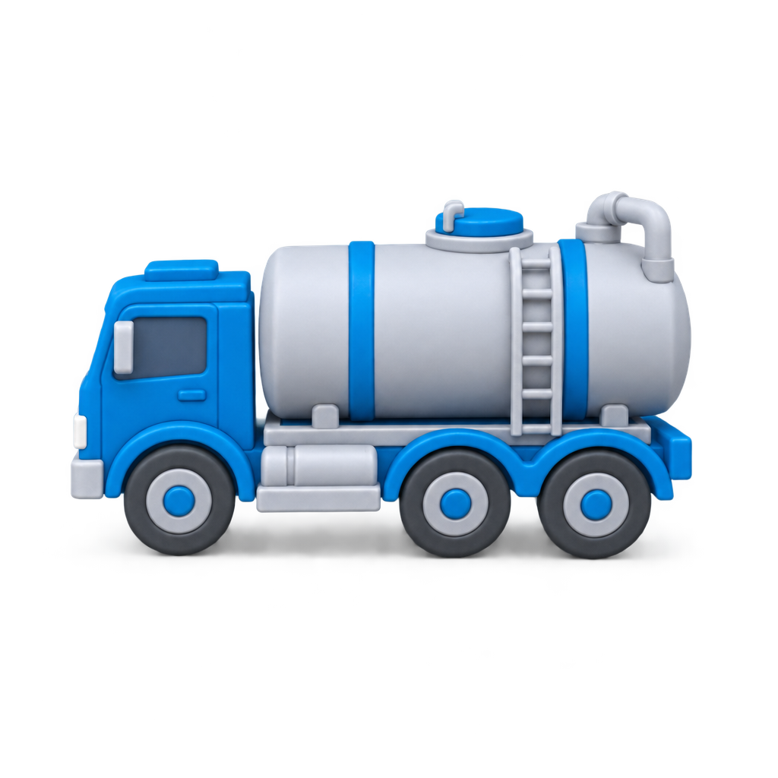
Bulk Supply Chain Challenges
Supplier
Delivery from
Supplier
Production &
Movement
Storage
Loading
Delivery to
Customer
Payment
Physical Bulk
Supply Chain
Inbound
Production
Outbound
Physical Discrepancies
Operational Pains
SAP Business
Process
Purchase
Order
Goods Receipt
Manufacturing,
Stock Transfer
Sales Order
Planning, Dispatch, Loading
Delivery,
Unloading
Billing, Payment,
Financial Close
Business Consequences

Slide 5
Bulk Supply Chain Challenges
Supplier
Delivery from
Supplier
Production &
Movement
Storage
Loading
Delivery to
Customer
Payment
Physical Bulk
Supply Chain
Inbound
Production
Outbound
Physical Discrepancies
Temperature volume changes
Imperfect measurement
Tank Capacities
Operational Pains
SAP Business
Process
Purchase
Order
Goods Receipt
Manufacturing,
Stock Transfer
Sales Order
Planning, Dispatch, Loading
Delivery,
Unloading
Billing, Payment,
Financial Close
Business Consequences

Slide 6
Bulk Supply Chain Challenges
Supplier
Delivery from
Supplier
Production &
Movement
Storage
Loading
Delivery to
Customer
Payment
Physical Bulk
Supply Chain
Inbound
Production
Outbound
Physical Discrepancies
Delays
System blocks
Operational Pains
Manual effort
Errors cascading
through the process
SAP Business
Process
Purchase
Order
Goods Receipt
Manufacturing,
Stock Transfer
Sales Order
Planning, Dispatch, Loading
Delivery,
Unloading
Billing, Payment,
Financial Close
Business Consequences

Slide 7
Bulk Supply Chain Challenges
Supplier
Delivery from
Supplier
Production &
Movement
Storage
Loading
Delivery to
Customer
Payment
Physical Bulk
Supply Chain
Inbound
Production
Outbound
Physical Discrepancies
Operational Pains
SAP Business
Process
Purchase
Order
Goods Receipt
Manufacturing,
Stock Transfer
Sales Order
Planning, Dispatch, Loading
Delivery,
Unloading
Billing, Payment,
Financial Close
Business Consequences
Expensive effort and time
in the manual updates
Inaccurate inventory
and financials
Slower
revenue
Books that don’t
close
Audit & regulatory
challenges

Slide 8
Bulk Supply Chain Solutions: SAP S/4HANA SDM
Supplier
Delivery from
Supplier
Production &
Movement
Storage
Loading
Delivery to
Customer
Payment
Physical Bulk
Supply Chain
Inbound
Production
Outbound
SAP S/4HANA
Secondary Distribution &
Automation Management
1
2
3
Monitor
Monitor
Capture and validate key physical supply chain events:
load and delivery confirmations
tanks, trucks, and transport data
SAP Business
Process
Purchase
Order
Goods Receipt
Manufacturing,
Stock Transfer
Sales Order
Planning, Dispatch, Loading
Delivery,
Unloading
Billing, Payment,
Financial Close

Slide 9
Bulk Supply Chain Solutions: SAP S/4HANA SDM
Supplier
Delivery from
Supplier
Production &
Movement
Storage
Loading
Delivery to
Customer
Payment
Physical Bulk
Supply Chain
Inbound
Production
Outbound
SAP S/4HANA
Secondary Distribution &
Automation Management
1
2
3
Monitor
Reconcile
Closing the gap between:
physical vs. financial
planned vs. actual
billed vs. delivered
Resolved into adjustments for orders, inventory, finance
Reconcile
SAP Business
Process
Purchase
Order
Goods Receipt
Manufacturing,
Stock Transfer
Sales Order
Planning, Dispatch, Loading
Delivery,
Unloading
Billing, Payment,
Financial Close

Slide 10
Bulk Supply Chain Solutions: SAP S/4HANA SDM
Supplier
Delivery from
Supplier
Production &
Movement
Storage
Loading
Delivery to
Customer
Payment
Physical Bulk
Supply Chain
Inbound
Production
Outbound
SAP S/4HANA
Secondary Distribution &
Automation Management
1
2
3
Monitor
Post
Automated posting of the adjustments along the full document chain, linked to the digital proof of delivery.
No physically unverified data enters FI/CO.
Reconcile
Post
with Agentic AI*
SAP Business
Process
Purchase
Order
Goods Receipt
Manufacturing,
Stock Transfer
Sales Order
Planning, Dispatch, Loading
Delivery,
Unloading
Billing, Payment,
Financial Close

Slide 11
Bulk Supply Chain Solutions: SAP S/4HANA SDM
Supplier
Delivery from
Supplier
Production &
Movement
Storage
Loading
Delivery to
Customer
Payment
Physical Bulk
Supply Chain
Inbound
Production
Outbound
Monitor
SAP S/4HANA
Secondary Distribution & Automation Management
Reconcile
Post
with Agentic AI*
Exceptions
Orchestrate
Order
Forecast
Configure
*Labs Preview + Roadmap
SAP Business
Process
Purchase
Order
Goods Receipt
Manufacturing,
Stock Transfer
Sales Order
Planning, Dispatch, Loading
Delivery,
Unloading
Billing, Payment,
Financial Close

Slide 12

Bulk Supply Chain Solutions: SAP S/4HANA SDM
Supplier
Delivery from
Supplier
Production &
Movement
Storage
Loading
Delivery to
Customer
Payment
Physical Bulk
Supply Chain
Inbound
Production
Outbound
SAP S/4HANA
Secondary Distribution & Automation Management
Monitor
Reconcile
with Agentic AI*
Post
Exceptions
Orchestrate
Order
Forecast
Configure
*Labs Preview + Roadmap
SAP Business
Process
Purchase
Order
Goods Receipt
Manufacturing,
Stock Transfer
Sales Order
Planning, Dispatch, Loading
Delivery,
Unloading
Billing, Payment,
Financial Close
Strategic SAP Fit
Seamlessly integrated into the SAP landscape — enabling end-to-end processes and maximum value.
SAP S/4HANA
Clean, consistent processes
SAP TM
Extends transport planning with operational feedback
SAP IBP
Better data foundation for planning
SAP Business AI
Trusted data as a prerequisite

Slide 13
Bulk Supply Chain Solutions: SAP S/4HANA SDM
Supplier
Delivery from
Supplier
Production &
Movement
Storage
Loading
Delivery to
Customer
Payment
Physical Bulk
Supply Chain
Inbound
Production
Outbound
SAP S/4HANA
Secondary Distribution & Automation Management
Monitor
Reconcile
Post
Exceptions
Orchestrate
Order
Forecast
Configure
SAP Business
Process
Purchase
Order
Goods Receipt
Manufacturing,
Stock Transfer
Sales Order
Planning, Dispatch, Loading
Delivery,
Unloading
Billing, Payment,
Financial Close
Strategic SAP Fit
SAP S/4HANA
SAP TM
SAP IBP
SAP Business AI
Seamlessly integrated into the SAP landscape — enabling end-to-end processes and maximum value.
Clean, consistent processes
Extends transport planning with operational feedback
Better data for operational & financial planning
Trusted data as a prerequisite

Slide 14
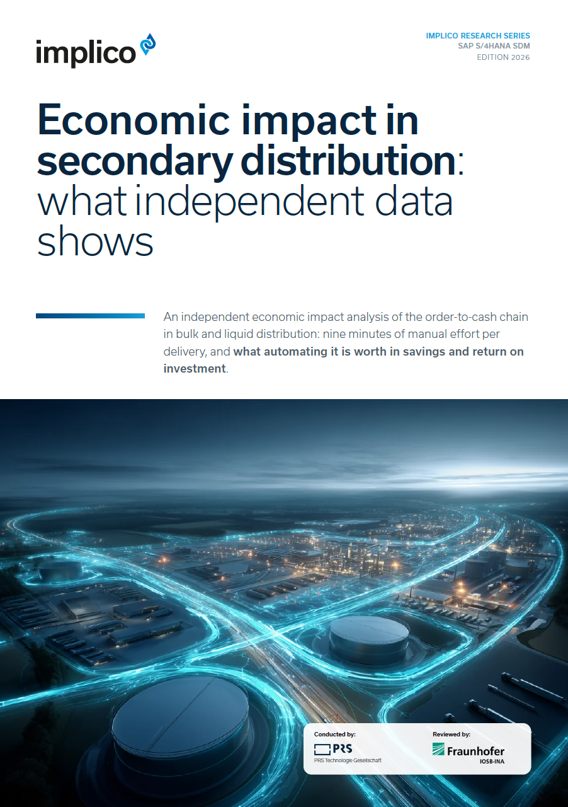

200%+
SAP S/4HANA SDM:
Clear Economic, Operational & Strategic Benefit
  three-year ROI
Get paid faster, with
far less effort
Margin transparency,
clean data
Close books easily,
stay audit-ready
SAP Standard & Trust
All figures are based on
our joint study with the Fraunhofer Institute.
Larger operations will see greater benefits, find more details and generate your own benefit levels here.
Your order-to-cash cycle shortens and your back office stops collecting, correcting and re-keying delivery data to get a clean number into finance.
Steer on daily numbers, fix errors right away. Clean transaction-level data is the foundation for operational & financial planning, and for AI across the enterprise.
When the auditor or the tax authority asks where a number came from, the number is already in the system, linked to the delivery that produced it.
SAP S/4HANA standard solution, already connected into the systems and processes that run your business, with a Clean Core.
500k+
400k+
80 to 95%
400k+
  EURO annual order-to-cash savings
  EURO annual reduced costs
  with transparency
  fewer malicious errors —
  theft, misconduct
  EURO annual savings on
  maintenance and downtime
83%
15
87%
3 FTE
  less manual processing time per delivery
  Days faster error resolution
  Reduction in reconciliation
  maintenance saved

Slide 15

















Why Us, Why Implico
Implico: A Trusted Partner
Our Partnership
with SAP
40 years
The only SAP roadmap partner for downstream
Implico is SAP’s sole Solution Extension (SolEx) partner for Secondary Distribution Management (SDM) and Retail Fuel Network Operations (RFNO).
Joint governance with
SAP industry leadership
SAP Industry executives are members of our Development & Advisory Board, ensuring roadmap integrity in line with SAPs Roadmap.
  of expertise
Serving customers in
> 180 Countries
Global Industry Leaders trusting Implico
> 1 million truck loads
scheduled per 24 hours
One Global
partner network
SAP S/4HANA Clean Core & Ind. Best Practices
All Implico SolEx components are certified, sold & distributed directly by SAP, fully aligned with the Clean Core strategy
25 years
of Partnership
Implico and SAP have co‑innovated to set the global standard for downstream supply‑chain automation. Our joint solutions power mission‑critical processes on five continents.

Slide 16




Bulk supply chain automation
Every manual booking is time AI could
hand back to your team.
Only verified data reaches the books. Exceptions surface automatically, and every booking stays traceable from terminal to dispenser.
Scan to book a session
-83%
-87%
  time per delivery
  (SDM)
  time per station
  per day (RFNO)
Quick ROI and payback, millions saved.
Get your automation score
30 minutes, scoped to your figures
implico.com

Slide 17

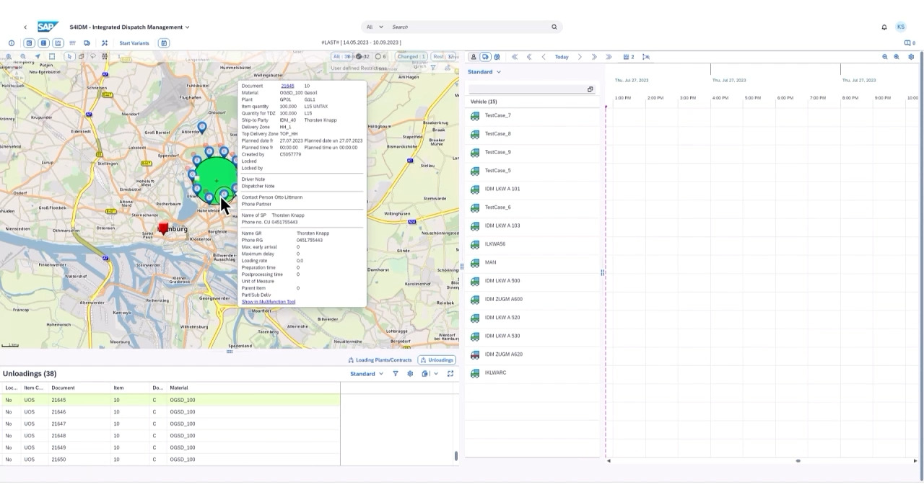


SAP S/4HANA SDM
SAP S/4HANA SDM
matters for
SAP Supply Chain Sales
SAP-native process automation along the supply chain, delivered as an SAP Solution Extension and fully relevant for SAP software quota attainment.
SAP SolEx Narrative
SAP standard offering
Strategic Relevance
SAP-branded. SAP-sold. SAP-supported.
Clean Core ABAP process automation
Transformation, value and pipeline
Official SAP Solution Extension on the
SAP price list
Positioned by SAP sales as part of the
SAP portfolio
100% quota relevant for SAP Supply Chain sales
SAP native automation of supply chain execution process
Standardizes business transactions & reduces manual effort
Supports clean core by reducing custom developments & interfaces
Strengthens SAP S/4HANA and Clean Core conversations
Connects process pain to measurable business value
Creates qualified SAP software pipeline and transformation opportunities
• Positioned by SAP sales as part of the SAP portfolio
• Standardizes business transactions & reduces manual effort
• Connects process pain to measurable business value
• 100% quota relevant for SAP Supply Chain sales
• Supports clean core by reducing custom developments & interfaces
• Creates qualified SAP software pipeline and transformation opportunities

Slide 18
SAP S/4HANA SDM
SAP S/4HANA SDM
matters for
Partners
SAP-native process automation along the supply chain, delivers multiple revenue opportunities for SI’s throughout the entire SAP lifecycle.
Win
Deliver
Grow
Enter larger SAP transformations
Differentiate with downstream IP
Accelerate value discovery
Derisk in project
Lead implementation and integration
Protect Clean Core principles
Reduce delivery risk with expert QA
Create rollout, AMS and optimization work
Expand by geography and use case
Build durable customer relevance
• Positioned by SAP sales as part of the SAP portfolio
• Standardizes business transactions & reduces manual effort
• Connects process pain to measurable business value
• 100% quota relevant for SAP Supply Chain sales
• Supports clean core by reducing custom developments & interfaces
• Creates qualified SAP software pipeline and transformation opportunities

